Slide 1
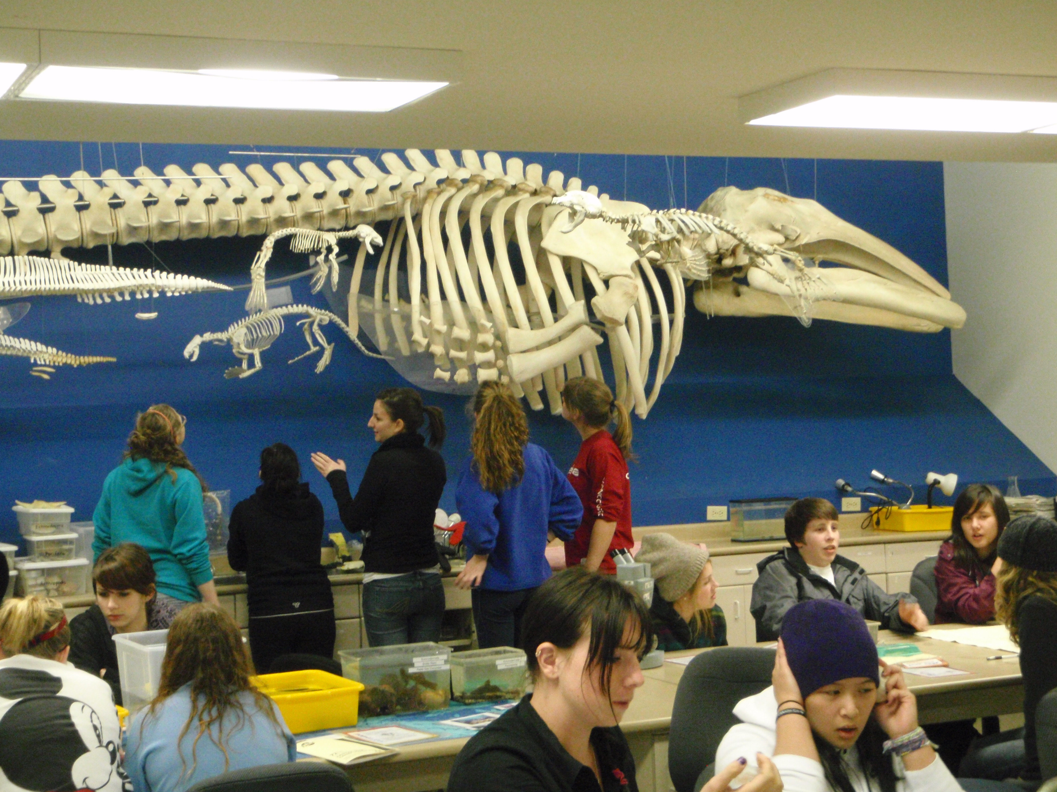
Bamfield Marine Station!

Slide 2
Getting there is half the fun….
Bamfield is located at the north end of the West Coast Trail.
There are no paved roads leading to this small town.
West Bamfield has no road access at all, the residents all travel by boat.

Slide 3
BMS is operated as a University
Owned and operated by UBC, UVic, SFU, University of Calgary and University of Alberta.
Part of its mandate is to provide the public with experiential educational opportunities.

Slide 4
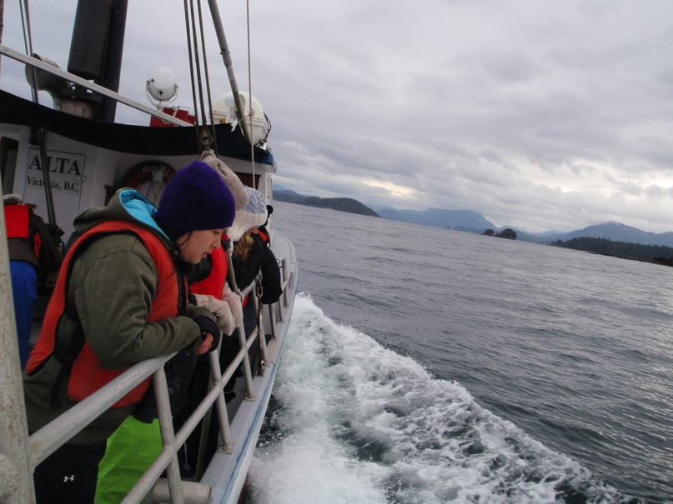
Field trips...
…boat trips…

Slide 5
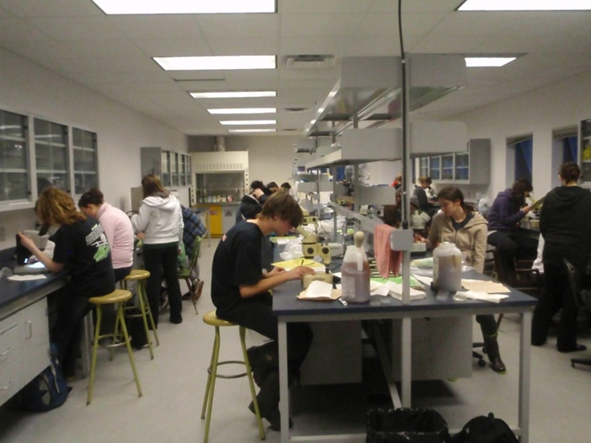
…some hands on lab work with our collections…
….a little bit of class work…

Slide 6
You should go if…
You are considering natural sciences in college or university.
You enjoy the outdoors and living things.
You crave adventure…or at least like dressing up like a fisherman!
You will leave early and miss a day Friday, returning Sunday night.
All meals and accommodations are included.
You will have some time to work on any homework.
You will have a great time!

