Slide 1
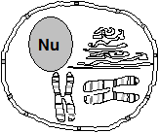
VI.Cell Structures and Their Functions
Nucleus
Large, centrally located
2. Surrounded by a double layer membrane with pores for selective intake and release of molecules - a nuclear envelope
3. Contains:
a. Nucleoplasm
b. Chromosomes
i. Contain DNA and organizer proteins (histones) densely coiled together
ii. Only visible near the time of cell division, when condensed for “transport’’; otherwise it is called chromatin
iii. Contains all the genetic code for the organism

Slide 2
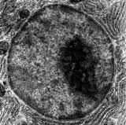
Nucleus Cont’d
C. Nucleolus
i. Dark-staining areas in the
nucleus (usually spherical)
ii. Contain genetic material for
making a form of RNA called ribosomal RNA (rRNA)
iii.rRNA travels to the cytoplasm, where it forms the sub-units of the ribosomes
4. Function: Transcription (reading) and replication (duplicating) of the genetic code occurs here

Slide 3
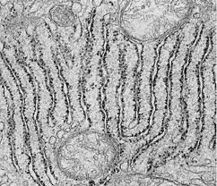
Ribosomes
1. Small dense-staining granules
2. Composed of rRNA and some proteins that are joined prior to migration to the ER
3. Found on surface of ER (for producing proteins to be exported out of cell)
4. Also found free-floating in cytoplasm in small groups called poly(ribo)somes a. polysomes produce proteins to be used inside the cell.
5.Function: Involved in protein synthesis (ensure correct amino acids and makes peptide bonds

Slide 4
Endoplasmic Reticulum
ANIMATION

Slide 5
C. Rough ER (Endoplasmic Reticulum)
Series of tubular canals
connected in places with
nuclear membrane
2. Covered with ribosomes
a. Ribosomes produce proteins to be exported out of cell
b. Proteins move inside to the lumen of the E.R. , then on to the Golgi apparatus
3. Function: Produces/modifies proteins to be exported by the cell

Slide 6
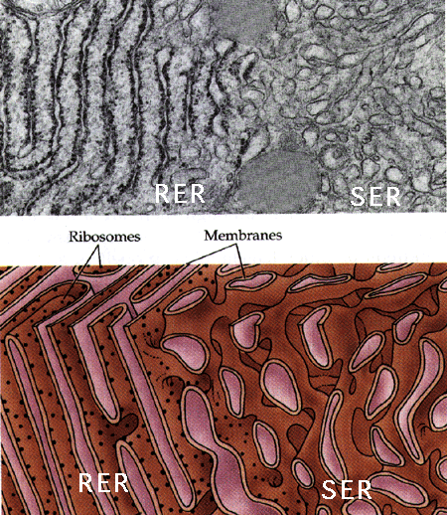
D. Smooth ER
1. Similar in structure to rough ER except no ribosomes on surface 2. Associated with lipid and steroid production [abundant in organs that produce steroid hormones (ovaries, testes, adrenal cortex)]

Slide 7
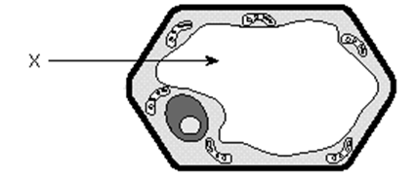
E. Vacuoles
Non-living, and much
larger in plant cells
Membrane-covered sack usually filled with water and waste chemicals
3. Small vacuoles are called vesicles

Slide 8
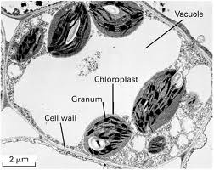
4. Function in plant cells:
a. Have one large central vacuole that may occupy 90% of the cell volume
b. Give rigidity to the cell (“pressurized”)
c. Makes the cytoplasm into a thin layer against the cell membrane to allow for better gas exchange
d. Storage of waste products of metabolism

Slide 9
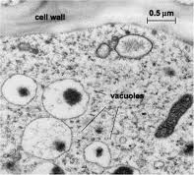
5. Function in animal cells:
a. Digestion of food
(e.g. food vacuoles in Amoeba)
b. Elimination of excess water
(e.g. contractile vacuole in
Paramecium)

Slide 10
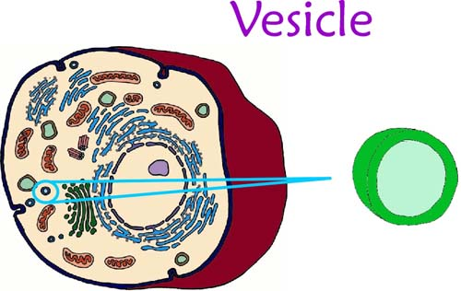
F. Vesicle
A small vacuole
2. Often used to move certain compounds require separation from the cytoplasm
(e.g. “bleb” off the Golgi, or are formed by infoldings of cell membrane)

Slide 11
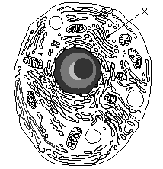
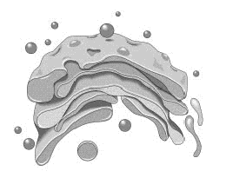
G. Golgi Body (Golgi Apparatus)
Looks like a series of flattened pancakes
2. Materials which are produced elsewhere in the cell (esp. E.R.) are temporarily stored here
3. Materials are packaged into vesicles
which pinch off from the edges
a. These vesicles are distributed within the cell or are shipped to the cell membrane for excretion

Slide 12
H. Lysosomes
1. Membrane-covered vesicles of hydrolytic enzymes which move throughout the cell
2. Produced by the Golgi
3. Functions:
a. Attach to food vacuoles and digest contents b. Destroy old or malfunctioning cell parts
c. Destroy the cell itself if the cell becomes damaged or malfunctions

Slide 13
I. Mitochondria
cristae
matrix
1. Double membraned structure where the inner membrane is highly infolded into cristae to increase inner surface area
a. Cristae : where enzymes are arranged in order to carry out certain reactions

Slide 14
Found in both plant and animals cells
Have own DNA (endosymbiont hypothesis)
4. Function:
Convert food energy to a form of energy which can be used by the cell (this energy is in the form of ATP: adenosine triphosphate)
b. Process: cellular respiration
Glucose + O₂ → CO₂ + H₂O + ATP energy
c. The more active a cell is, the more mitochondria it will have (e.g. muscle & sperm cells
Clip: powering the cell

Slide 15
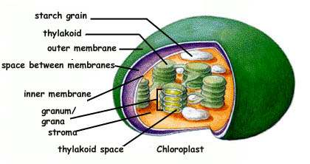
J. Plastids
Found only in plant cells
3 types of plastids:
a. Chloroplasts - most common
Structure:
i. Have “coin-like” membrane sacks (thylakoids) arranged in “stacks” called grana that are joined together by lamellae (membranes between stacks)
ii. The inner portion of the chloroplast is called the stroma

Slide 16
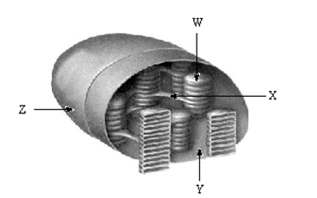
b. Contain chlorophyll (in grana)
Site of photosynthesis
(H₂O + CO₂ → sugar + O₂)

Slide 17
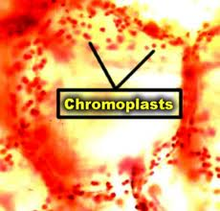
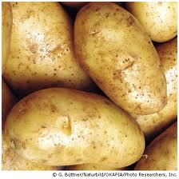
b. Chromoplasts
Stores pigments other than chlorophyll (e.g. carotene, xanthophylls) that make carrots, peaches, autumn leaves, etc. yellow & orange)
c. Leucoplast
Stores starch (e.g. in potatoes)

Slide 18
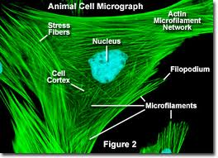
K. Microfilaments
1. Thin solid fibers of protein – similar to proteins in muscle fiber
2. Provide skeletal framework for the
cell (cytoskeleton)

Slide 19
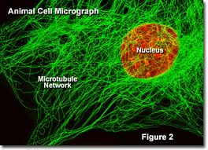
L. Microtubules
1. Larger than microfilaments
2. Proteins called tubulin are coiled in a cylindrical fashion (think Slinky) around a central lumen
3. Found in cilia, flagella and centrioles
4. Provide skeletal framework for the cell (cytoskeleton)

Slide 20
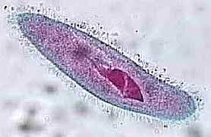
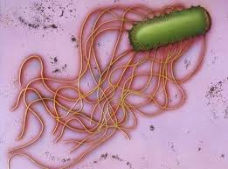
M. Cilia and Flagella
1. Hairlike projections of the cell
a. cilia - short and many
b. flagella - long and few
Composed of protein fibres that are able to contract and cause the cilia or flagella to beat or wave back and forth
3. For cell locomotion, or generating current

Slide 21
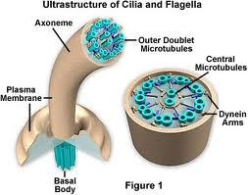
Inside (cross-section):
a. A "9 + 2" arrangement of
microtubules
b. Except: in their basal body (anchor in cytoplasm) where the two central tubules are gone (a "9 + 0" pattern)

Slide 22
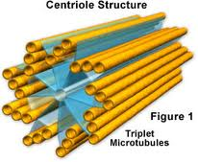
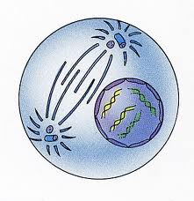
N. Centrioles
Are short cylinders with a “9+0” pattern
Produce the basal bodies of cilia and flagella
Probably involved in some way with the formation of spindle fibres in the mitotic process
Usually 2 centrioles lie on either side of the nucleus (during times of nuclear division)
5. Found in all animal cells

Slide 23
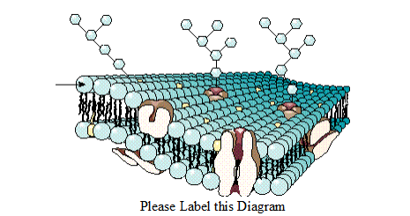
O. Cell Membrane
1. The cell membrane functions in transport of materials in and out of cell, recognition, communication, and homeostasis

Slide 24
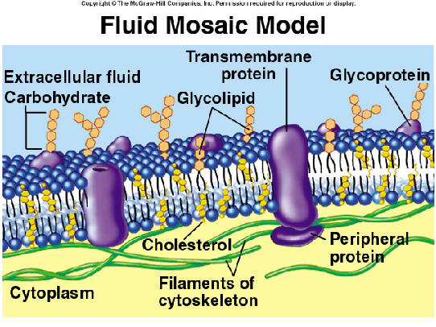
2. The Fluid Mosaic Model:
a. Cells are surrounded by a thin membrane of lipid and protein, about 100 angstroms (100 x 10-10 m) thick.
b. The cell membrane is a remarkable structure that has properties of a solid and a liquid.
c. It forms a "fluid sea" in which proteins and other molecules like other lipids or carbohydrates are suspended (like icebergs) or anchored at various points on its surface.

Slide 25
d. The “sea” or “fluid” part is composed of side by side phospholipids arranged in a bilayer (called a lipid bilayer).
e. The solid part (the “mosaic”) is the variety of proteins etc. embedded in the bilayer.
f. Each phospholipid has a hydrophobic tail and a hydrophylic head

Slide 26
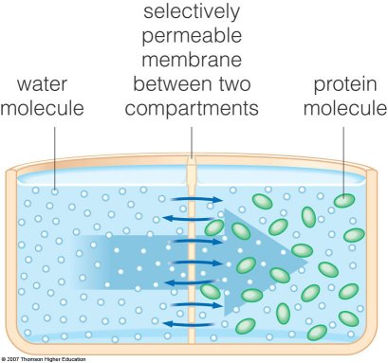
The membrane has consistency of light machine oil.
4. The membrane is selectively permeable (will let some substances in but not others of the same size).

Slide 27
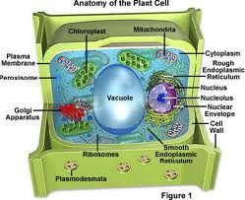
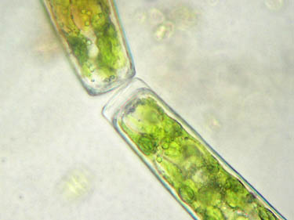
P. Cell Wall
Only in plant cells
Made of cellulose (sugars linked with a strong bond)
Very rigid (but porous) and difficult for animals to digest (think “wood”)
4. Small molecules have little difficulty penetrating the cell wall, while larger molecules may not be able to pass through. (the cell wall is said to be semi-permeable)

Slide 28
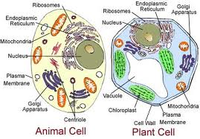
VII.Plant Cell vs. Animal Cell
A. Plant cells have:
1. A cell wall
2. Plastids
3. A large central vacuole… animal cells do not!
B. Animal cells have
1. Centrioles … plant cells do not!

Slide 29
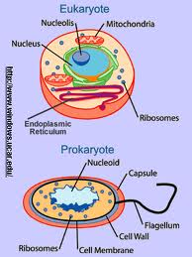
VIII.Prokaryotes vs. Eukaryotes
Two classes of cells exist: the PROKARYOTES and the EUKARYOTES
B. The Prokaryotes include the bacteria and the blue-green algae (the Monera kingdom).
1. These are all single-celled organisms that lack both a true nucleus and other membrane-bounded cellular substructures.
2. Prokaryotic DNA is usually circular.

Slide 30
 |  | Eukaryotic
Structure | Prokaryotic | Animal | Plant
Cell Membrane | YES | YES | YES
Cell Wall | YES | NO | YES
Nucleus | NO | YES | YES
Mitochondria | NO | YES | YES
Chloroplasts | NO | NO | YES
ER | NO | YES | YES
Ribosomes | YES, small | YES, large | YES, large
Vacuoles | NO | YES, small | YES
Lysosomes | NO | YES, usually | NO, usually
Cytoskeleton | NO | YES | YES
Centrioles | NO | YES | NO
C. The Eukaryotes include plants, animals, protozoa, and fungi.
1. These cells contain nuclei and other membrane-bound organelles.
2. The genetic material is organized into chromosomes.

