Slide 1
Protistans
Notes:
Amoeba sisters – protists and fungi video: https://www.youtube.com/watch?v=zK7Ckmxxqds
Show up to 4:45

Slide 2
18-1: Introduction to Protists
Introduction
Protista means first in the Greek language
Protist: Unicellular, or single-celled, eukaryotic organisms
Some are solitary, meaning: that they live as individual cells
Some are colonial, meaning: that they live in groups of individuals of the same species that are attached to one another

Slide 3
Classification of Protists:
Kingdom very diverse: over 115, 000 species
These species difficult to classify because: they had characteristics in common with more than one of the three kingdoms of multicellular organisms: Animalia, Plantae and Fungi
This Kingdom exists primarily: to solve the problem of classifying these difficult organisms.
Lynn Margulis says Kingdom Protista is defined by: exclusion: its members are neither animals, plants, fungi, nor prokaryotes.

Slide 4
18-2: Animal-like Protists
Ciliophora phyla within the kingdom are “animal-like”
Ciliophora: Cilia-Bearing Protists
Characteristics: Either solitary or colonial organisms
Nickname: ciliates
Cilia are: short hairlike projections
Beating of cilia propels the cell thru water

Slide 5
Focus on Paramecium
Size: 350 µm in length
Details of exterior:
Pellicle (def’n): complex living outer layer made of cell membrane and associated underlying structures
Embedded in pellicle are trichocysts
Used for defence
Used to injure nearby cells and cover Paramecium in protective bristles
2 different nuclei:
Large macro nucleus [transcription nucleus]
Small micro nucleus [reproductive nucleus]
Movement

Slide 6
Feeding:
Uses cilia to direct water into gullet
Food (e.g. bacteria) forced into cavities called food vacuoles
Break off into cytoplasm and circulate, eventually fusing with lysosomes
Digestion:
Lysosome (def’n): organelles that contain digestive enzymes
Waste Removal:
“Used” food vacuoles fuse with region of cell membrane called the anal pore
Excretion
Water flows into Paramecium due to osmosis
Expelled by process:
Excess water collects in other vacuoles
Vacuoles fuse with canals located around the contractile vacuoles
When filled, this organelle contracts quickly and pumps water out

Slide 7
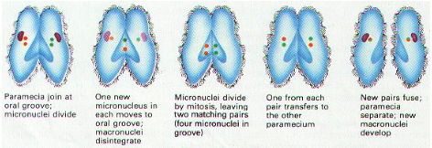
Reproduction
Mostly asexual by binary fission (mitosis) results in 2 cells that are genetically identical
Under stresses such as starvation or temperature, Paramecium will engage in sex by process of conjugation
Conjugation is not REPRODUCTION, because no additional cells are produced but it is a SEXUAL process because new combinations of genetic material result

Slide 8
II. Zoomastigina: Animal-like Protists with Flagella
Characteristics:
Move through water by means of flagella (def’n): long, whiplike projection that aids in movement in some cells
Feeding:
Absorb food through cell membranes
Some live within the bodies of other organisms and live as parasites
Giardia: lives in small intestine of humans
Trichomonas: causes intestinal and venereal disease in humans

Slide 9
III. Sporozoa: Spore-Producing Parasitic Protists
Characteristics:
Are non-motile and parasites on other organisms
Hosts can be worms, insects, fish, birds and humans
Life Cycle:
Usually complex, involving more than one host
Reproduce by means of spores
Spores attach and penetrate host cells

Slide 10
Focus on Plasmodium
Carrier (vector): the Anopheles mosquito
Infection process – human host
Mosquito saliva contains spores, which are injected into the bloodstream
First infects liver cells, then red blood cells (RBCs)
Grows rapidly, and lyse cells at regular intervals: 48 or 72 hours
Millions of bursting RBCs dump large amounts of toxins into bloodstream
Toxins produce symptoms: chills and fever

Slide 11
Infection process – mosquito host:
Mosquito feeds on an infected human: blood contains Plasmodium
In digestive system, rapidly spreads everywhere, including salivary glands
Combating malaria:
Drugs (e.g. chloroquinine) work on some forms, but some are resistant
Disrupt Plasmodium life cycle by destroying breeding areas for mosquito
Ethical Question: Do we Destroy the Mosquito?

Slide 12
IV. Sarcodina: Protists with False Feet
Characteristics:
Use temporary projections of cytoplasm to move and feed
Pseudopod means: false foot.
Shapes:
Rounded and broad
Thin, strand-like
Web-like
Phylum name comes from: sarcode which meant “jelly”
Movement

Slide 13
Focus on: Amoeba
Description: flexible, active cells without cell walls, flagella, cilia, and even a definite shape.
Move by “amoeboid movement”
Amebas move by means of thick pseudopods, which they extend out of the central mass of the cell
The cytoplasm of the cell streams into the pseudopod
The rest of the cell follows

Slide 14
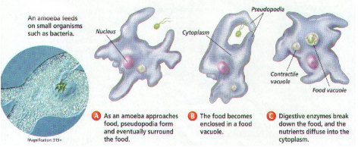
Feeding
Prey capture (process): It feeds by first surrounding its meal with streaming cytoplasm and then taking it inside the cell to form a food vacuole
Digestion (process): The material is digested rapidly and the nutrients are passed along to the rest of the cell
Reproduction
Binary fission – one large ameba divides by mitosis to produce two smaller, but genetically identical amoebas

Slide 15
Classification: Families of Sarcodina
Amoeba
Heliozoans
Radiolarians
Foraminifers
These last three groups’ characteristics:
Produce external shells
Shells made of:
Heliozoans/radiolarians: silica
Foraminifers: calcium carbonate

Slide 16
IV. How Animal-like Protists Fit into the World
Harmful relationships with humans
Protist | Vector | Name of Disease | Symptoms
Plasmodium | Anopheles mosquito | Malaria | Chills and fever
Trypansoma | Tsetse fly | African sleeping sickness | Fever, chills and skin rash
T. cruzi | Insect | Chaga’s disease | Weaken heart muscle
Entamoeba | Feces of infected individual | Amebic Dysentery | Diarrhea & intestinal bleeding

Slide 17
Helpful relationships:
Termites eat wood, which contains the carbohydrate cellulose, but don’t have the enzymes to break it down
Trichonympha living in termite gut manufacture the enzyme cellulase
Ecological role:
In food chains: are food for tiny multicellular animals, that in turn are food for larger animals

Slide 18
18-3: Plant-Like Protists
Characteristics:
Plant-like because they contain: the pigment chorophyll and carry out: photosynthesis
Classification:
3 of 5 phyla are sometimes called algae:
Euglenophyta
Pyrrhophyta
Chrysophyta
Slime mold phyla are sometimes called:
Arasiomycota
Myxomycota

Slide 19
I. Euglenophyta: Flagellates with Chloroplasts
Movement
Characteristics:
Closely resemble: Zoomastiginans – difference is euglenophytes possess chloroplasts
Focus on Euglena:
Description: long cell, with a pouch containing 2 flagella, the longer extending out of the pouch.
Movement:
Swims in water by using flagella
Crawls along surfaces by euglenoid movement

Slide 20
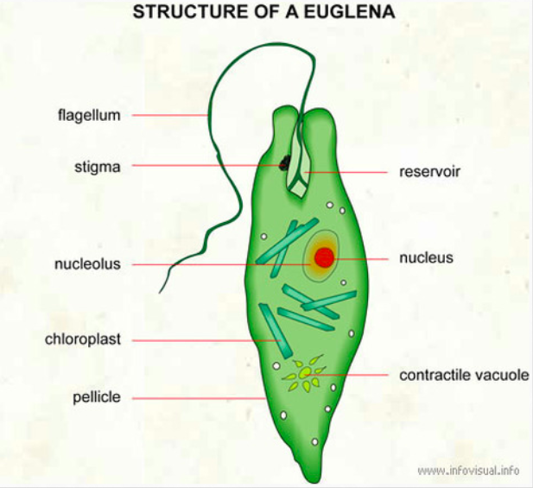
Finding sunlight:
Eyespot at front end helps find brightest areas in its environment
Making/Getting Food:
As an autotroph: uses its chloroplasts (in light) to photosynthesize
As a heterotroph: absorbs dissolved nutrients (in darkness)
Reproduction: by binary fission

Slide 21
II. Pyrrophyta: Fire Protists
Also known as dinoflagellates
Characteristics:
Most are photsynthetic
Swim by means of 2 flagella:
One wraps around like a belt
Other trails behind like a tail
Many have thick plates and look “armored”
Bioluminescence:
When agitated by sudden movement they give off light
Their name means ”fire plants”

Slide 23
III. Chrysophyta: Golden Protists
Classification
3 kinds: yellow-green algae, golden-brown algae and diatoms
Name means “golden plants” and refers to their chloroplasts
Characteristics:
Cell wall contains pectin, not cellulose
Energy stored as oil rather than starch

Slide 24
Focus on Diatoms
Cell walls
Made of glass!
Two halves fit together like a petri dish
One of the most abundant species in oceans!

Slide 25
IV. Slime Molds: Unusual Protists
Distribution:
Found near rich sources of food such as:
Rotting wood
Compost
Thick wet lawns
Classification:
Difficult to classify because at one stage they are amoeba-like cells and at others they produce mold-like masses that make spores
In the past, have been classified as amoebae and as fungi

Slide 26
Focus on Acrasiomycota
Life cycle stages:
Begin as individual cells (amoeba-like); mostly in this form
When food runs out, groups of cells gather to produce: a large mass of cells
This mass starts to function as a single organism
Migration: up to several centimeters
Reproduction:
Form a structure called a fruiting body
This makes spores by mitosis
These become amoeboid cells that repeat the cycle

Slide 27
V. How the Plant-Like Protists Fit Into the World
Distribution:
Found in: Fresh water, oceans and land
Harmful Relationships:
Euglenophyte blooms (cycle)
Excess waste dumped into water
Grow into enormous masses called “blooms”
Run out of nutrients & die, compounding the pollution clean-up problem

Slide 28
Dinoflagellate blooms (cycle)
Some species contain toxins that can paralyze or kill
People aren’t affected by swimming
Shellfish like clams and oysters trap them for food and concentrate the toxin
Eating shellfish from “red tide” areas can cause serious illness

Slide 29
Helpful Relationships:
Coral, sea anemones, and clams may have dinoflagellates as photosynthetic symbionts
Ecology
Phytoplankton (def’n): small photosynthetic organisms found floating at ocean’s surface
Importance:
More than 70%... of photosynthesis on Earth is done here!
Provide organisms on our planet with oxygen and food
Example food chain:
Phytoplankton → tiny animals → small fish →large fish → humans
(zooplankton) (tuna)

