Slide 1
Review: Formulas of Ionic compounds
What is the formula for calcium fluoride?
What is the formula for aluminum oxide?
What is the formula for iron (II) sulfide?
What is the formula for magnesium nitrate?
CaF₂
Al₂O₃
FeS
Mg(NO₃)₂ *Don't forget the brackets!

Slide 2
Review: Names of Ionic compounds
What is the compound name of Li₃N?
What is the compound name of Ni₂O₃?
What is the compound name of KBr?
What is the compound name of Na₃PO₄?
lithium nitride
nickel (III) oxide
potassium bromide
sodium phosphate

Slide 3
Naming & Formulas of Covalent Compounds

Slide 4
Diatomic Molecules
Diatomic molecules are two of the same atoms sharing electrons (covalent bond).
7 elements always act as diatomic molecules:
H₂, N₂, O₂, F₂, Cl₂, Br₂, I₂, At₂ (man-made)

Slide 5
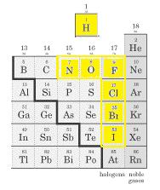
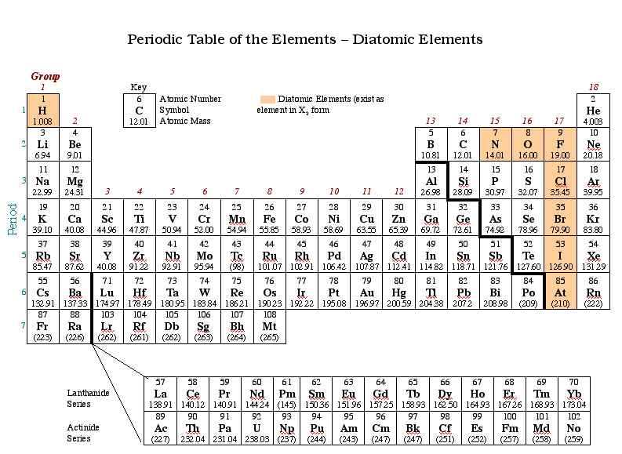
Diatomic Molecules
Follow the “H-7 Rule”
An easy-to-remember mnemonic for the diatomic elements is: Have No Fear Of Ice Cold Beer

Slide 6
Naming Covalent Compounds
Made of two anions (2 nonmetals or 1 nonmetal & 1 polyatomic ion)
The 1st nonmetal is just given the name as found on the Periodic Table (just like ionic)
The 2nd nonmetal ending is changed to –ide (just like ionic… don’t change polyatomics)
Difference = numerical prefixes are used to express how many of each nonmetal are present

Slide 7
Naming Covalent Compounds (cont.)
You never use “criss-cross” method
The only time you do not use a prefix is when there is only one of the first nonmetal ie. mono is never written in front of the first word
Number | Prefix
1 | mono
2 | di
3 | tri
4 | tetra
5 | penta
6 | hexa
7 | hepta
8 | octa
9 | nona
10 | deca

Slide 8
Practice: Naming Covalent Compounds
SO₂
N₂O
NO₂
CCl₄
Si₃N₄
Sulfur dioxide
Dinitrogen monoxide
Nitrogen dioxide
Carbon tetrachloride
Trisilicon tetranitride

Slide 9
Practice: Formulas of Covalent Compounds
Phosphorus trioxide
Dinitrogen pentacarbide
Tellurium nonaiodide
Carbon monoxide
Selenium heptafluoride
PO₃
N₂C₅
TeI₉
CO
SeF₇

Slide 10
Homework
Workbook pages 71 to 73

